Slide 1


Group 1
BUSN 3380 - Operation Management
Gary Sveinson, MBA PMP Prosci Certified
Presented by:
Thi Gia Tue Ho - 300283006
Adriano Braga Maso - 300335854
Rodrick Mascarenhas - 300337330
Eunhee Lee - 300355279
Thi Thu Huyen Nguyen - 300351638
Ramandeep Singh Kathuria - 300346364

Slide 2

WALMART
CONTENTS
Introduction
Design of Goods and Services
Managing Quality
Layout Strategy
Supply Chain Management
Inventory
Location Selection
Recommendations
Conclusion
References

Slide 3



WALMART
INTRODUCTION
Walmart succeeded in critical decision strategies
Opportunities for SMBs
Highlighting multiple studies of Walmart’s operations
Walmart’s slogan: “Everyday Low Price”

Slide 4
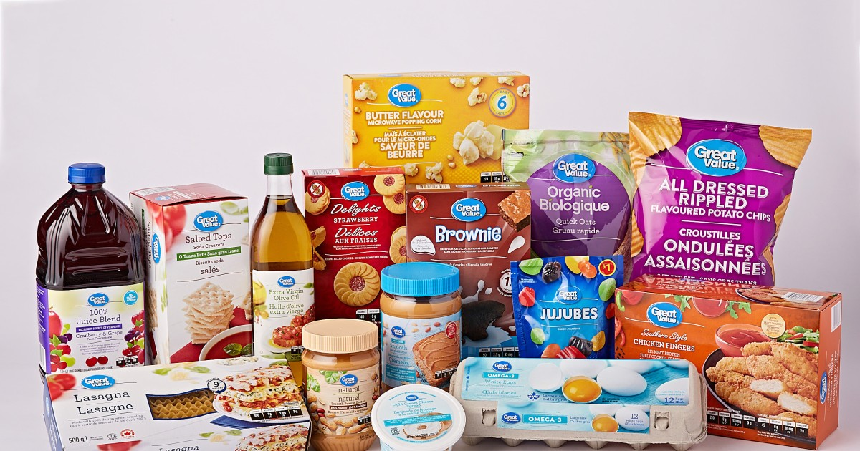
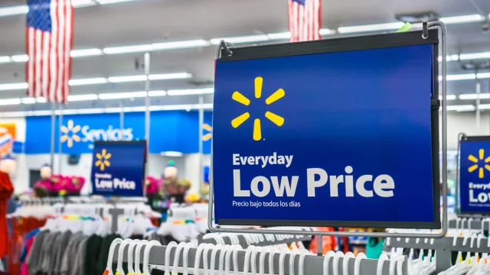
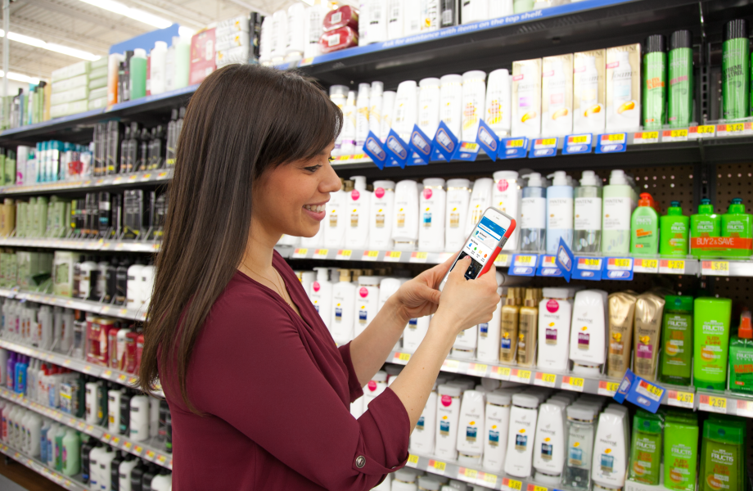
WALMART
PRODUCTS DESIGN
Product’s characteristics and performance
Improving the value at affordable price
Customer’s expectation

Slide 5
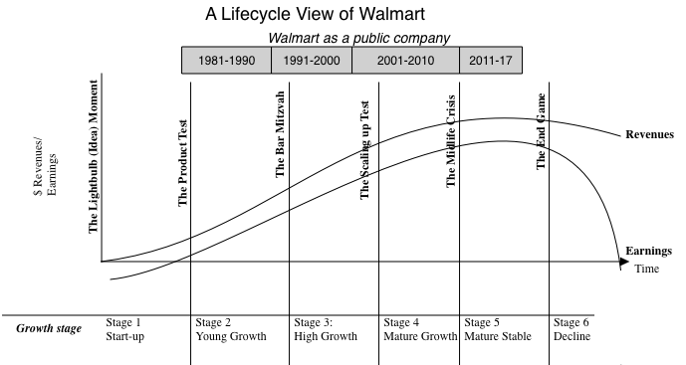
WALMART
PRODUCT LIFE CYCLE

Slide 6

WALMART
PRODUCT DEVELOPMENT
Issue:
Customer demand vs economic changes
Wide variety of product
Solution:
Improving shopping experience
Partnership with suppliers
Sustainable development

Slide 7
Managing Quality
WALMART
Managing quality helps build successful strategy of differentiation, low cost, and response.
Importance of quality | Company reputation, Product liability, Global implication
Total quality management(TQM) | The management of the entire organization, from supplier to customer.
Concepts for TQM | Continuous improvement, Six sigma, Employee empowerment
 | Benchmarking, Just-in-time, Taguchi concept, knowledge of TQM tools
Tools of TQM | Cause-and –effect diagram, Pareto charts, Flowcharts, Check sheet
TQM in services | Reliability, Credibility, Responsiveness, Courtesy, Competence etc

Slide 8
How Walmart manage quality?
WALMART
Inspections
Product quality and compliance manual
Quality Cart
Receipt of goods from the supplier
Before delivery to customers
Testing performed by third-party institutions
Standards and requirements to be followed by the supplier for the best.
To listen and anticipate what customers want and need
Places products on the shelves earlier
Weighing scales and boxes for discarded produce
Save disposal cost and time.

Slide 9
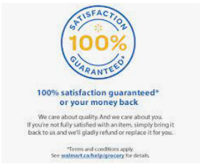
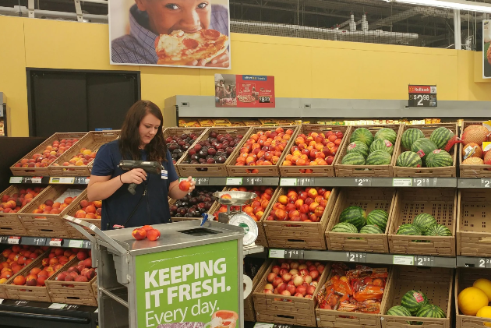
Return Policy
Quality Carts
Walmart's Quality Management
WALMART
Walmart. (n.d.-a). Walmart Canada. Walmart.Ca. Retrieved July 25, 2022, from https://www.walmart.ca/en/frais
WAHBA, P. (2016, July 13). Here’s How Walmart Is Making Sure Its Produce Stays Fresh. Fortune.Com. Retrieved July 13, 2022, from
https://fortune.com/2016/07/13/walmart-produce-quality-cart/

Slide 10
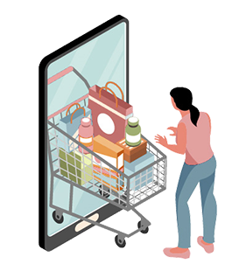
How Walmart manage quality?
Poka-yoke
Just-In-Time
Six Sigma
WALMART
Checklist index
List various processes, guidelines, testing requirements
Products are received when needed.
Reduce the need for space for large stock quantities,
improve cash flow and reduce the capital
Reducing the number of links in its supply chain:
Increasing efficiency & Orders on time & Save
money

Slide 11

Layout strategy
WALMART
Objective: “develop an effective and efficient layout that will meet the firm's competitive requirements”
Key Design Considerations:
Higher utilization of space, equipment, and people
Improved flow of information, materials, or people
Source- https://www.shopify.com/blog/business-plan

Slide 12
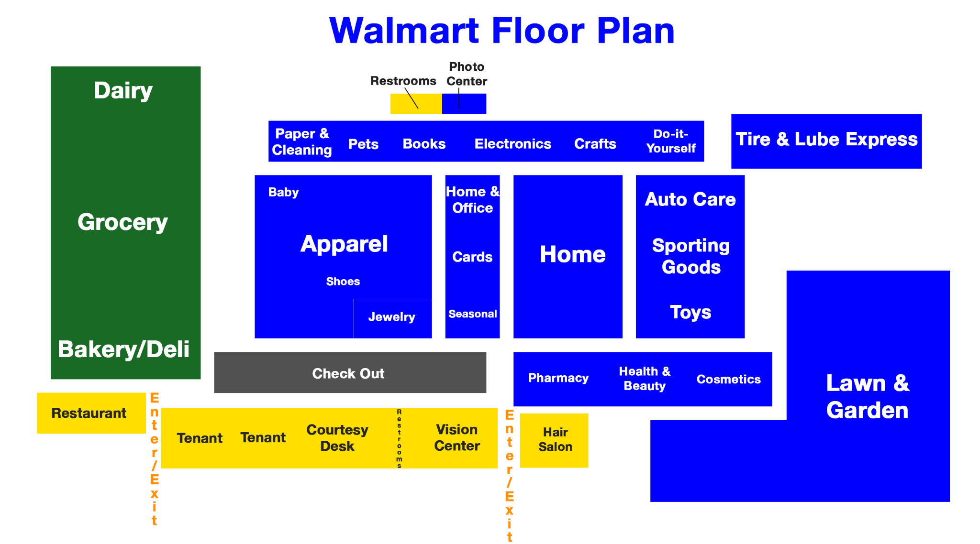
How Walmart does it?
WALMART
Walmart has been undergoing a shift for a number of years, reinventing how to create seamless omni-shopping experiences that inspire our customers whether they are buying in-person, online, or on their mobile device.
Source- https://247wallst.com/retail/2017/01/09/a-map-of-how-wal-mart-lays-out-its-stores-to-lift-sales/

Slide 13
Strategies Used by Walmart
WALMART
Traffic Generators
Eye (and purchase) level
Impulse zones
Making an impression through scent and colour
Making it difficult to locate items

Slide 14
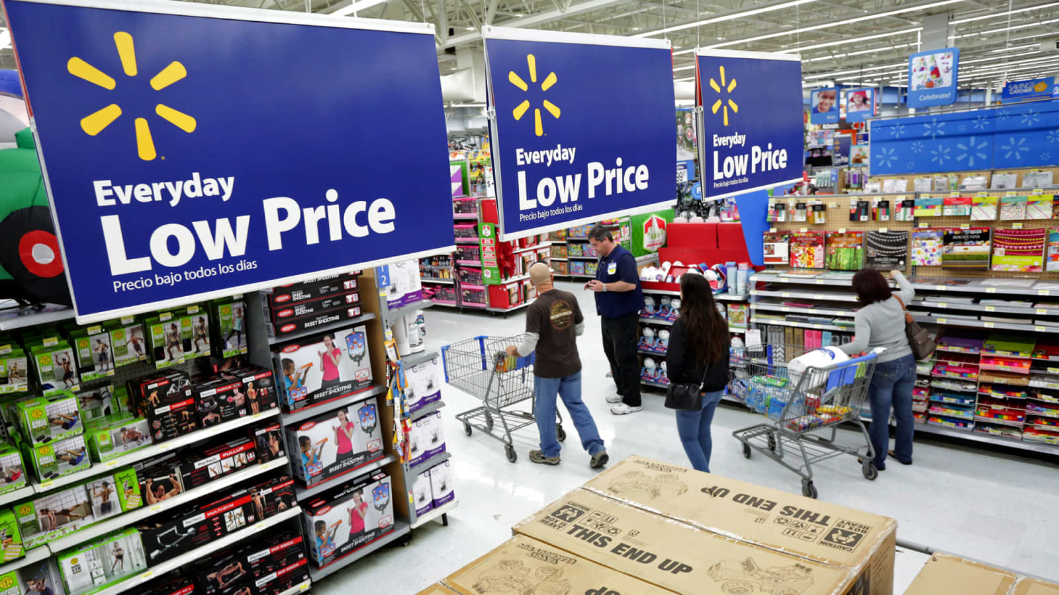
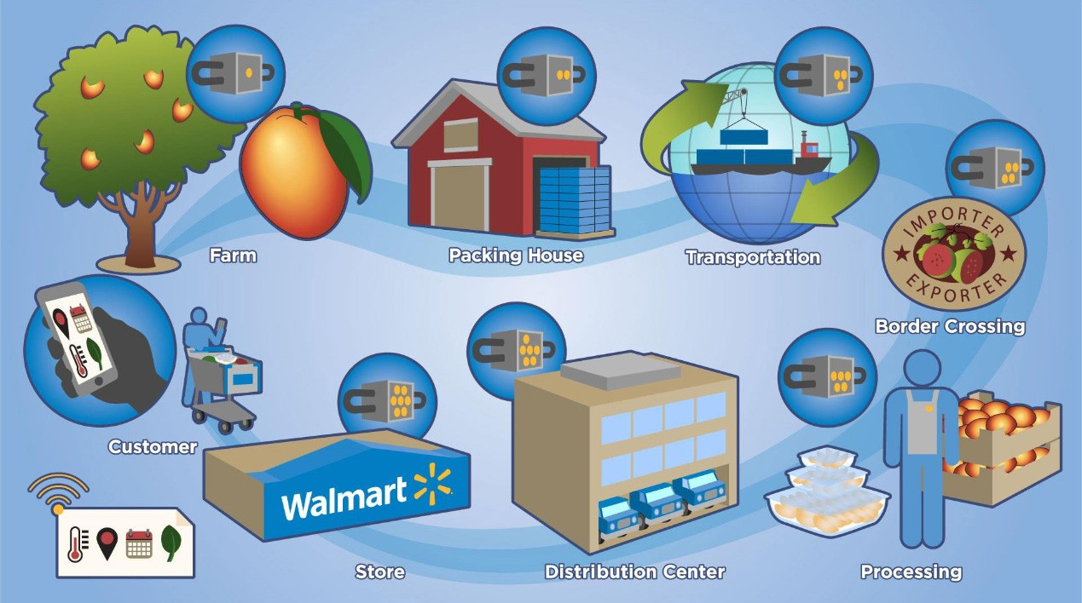
WALMART
SUPPLY CHAIN MANAGEMENT
Provide various products
Apply Everyday Low Price Strategy
Manage the supply chain
WALMART
https://www.cnbc.com/2017/02/27/wal-mart-launches-new-front-in-us-price-war-targets-aldi-in-grocery-aisle.html
https://einvestingforbeginners.com/walmarts-supply-chain-and-vmi-gnewl/

Slide 15
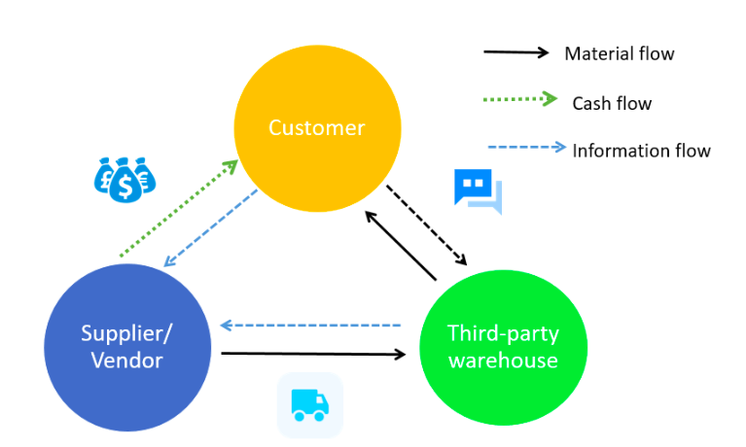
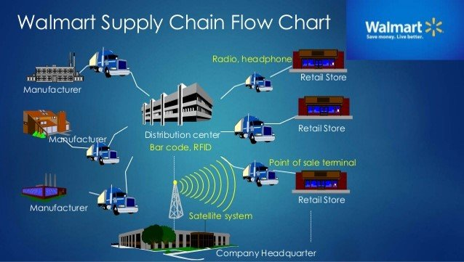
WALMART
SUPPLY CHAIN MANAGEMENT
Outsourcing
Vendor Managed Inventory
RFID Technology
WALMART
https://einvestingforbeginners.com/walmarts-supply-chain-and-vmi-gnewl/
https://www.researchgate.net/figure/Walmart-Supply-Chain-Flowchart_fig1_320021998

Slide 16
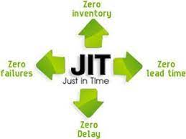
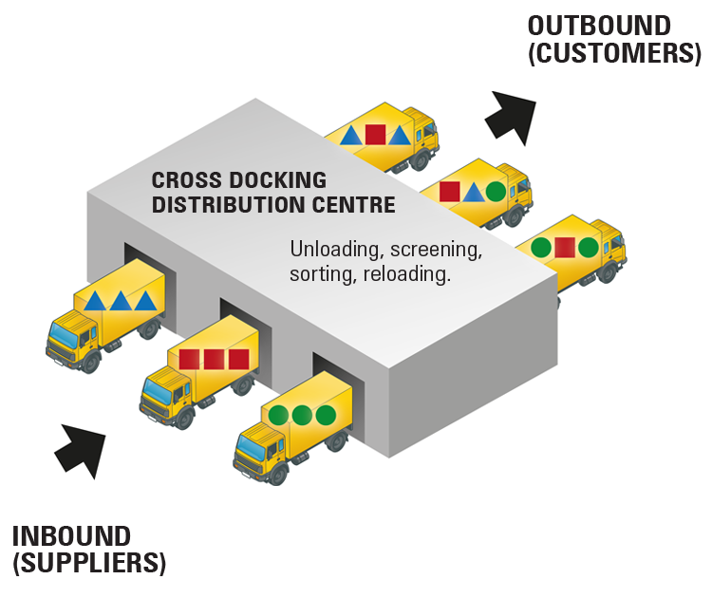
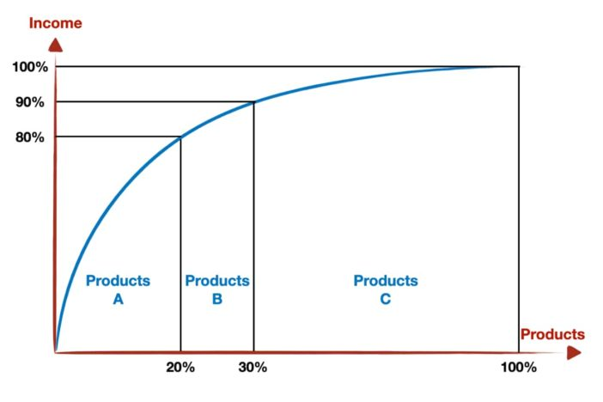

WALMART
INVENTORY
Just in time (JIT)
Cross-docking
ABC Analysis
Hi-technology
WALMART

Slide 17
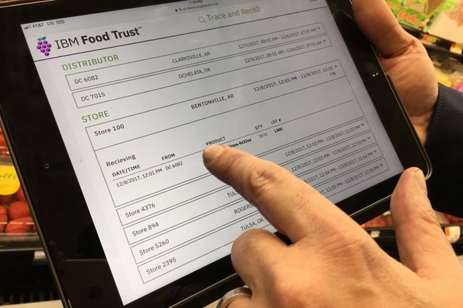
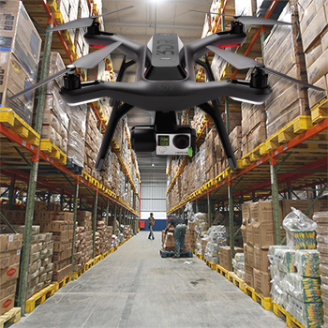
WALMART
INVENTORY
Blockchain to track fresh food
Drones in warehouse management
WALMART

Slide 18
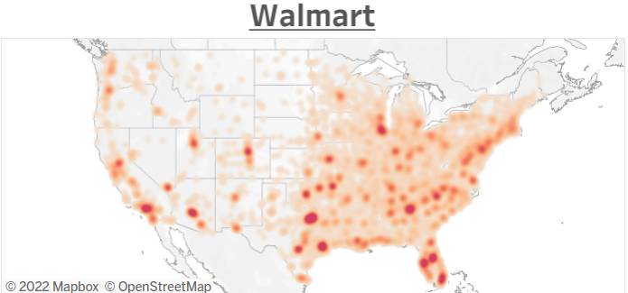
Location Strategy
WALMART
Prominent neighbourhoods
Outside city centers
Lower average income per capita
Feasible inventory management
Highly populated areas
https://jordanbean.com/blog/how-can-data-help-site-selection

Slide 19
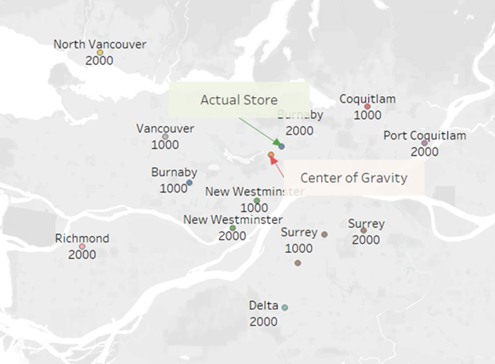
Location Strategy
WALMART
13 supercenters within BC
x-y coordinates with number of shipments (weighted value)
center-of-gravity method
final call

Slide 20
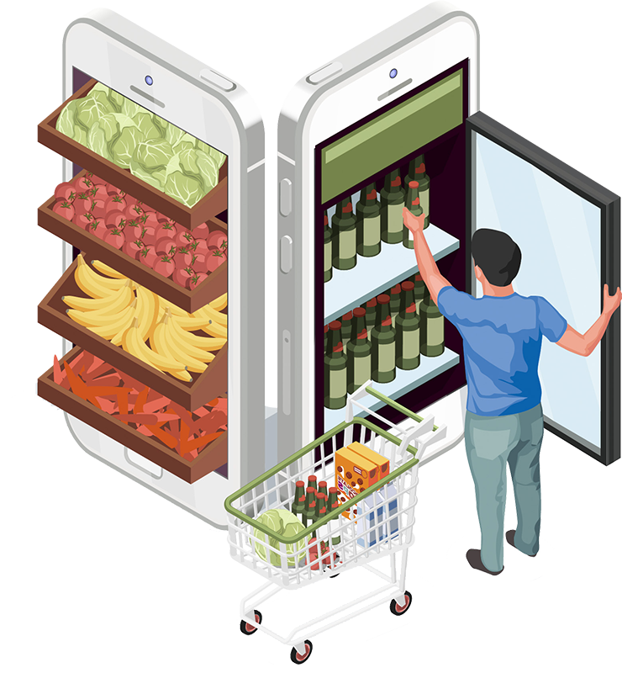
Recommendations
WALMART
Short term recommendations
Displaying the expected arrival date on the shelves & website
Focus more on quality, not just on price
Judge the freshness from customer’s eye level.
More empowerment and quality management training for employees.
Long term recommendations
Enhance the competitiveness of its private
label brands “Great Value”

Slide 21
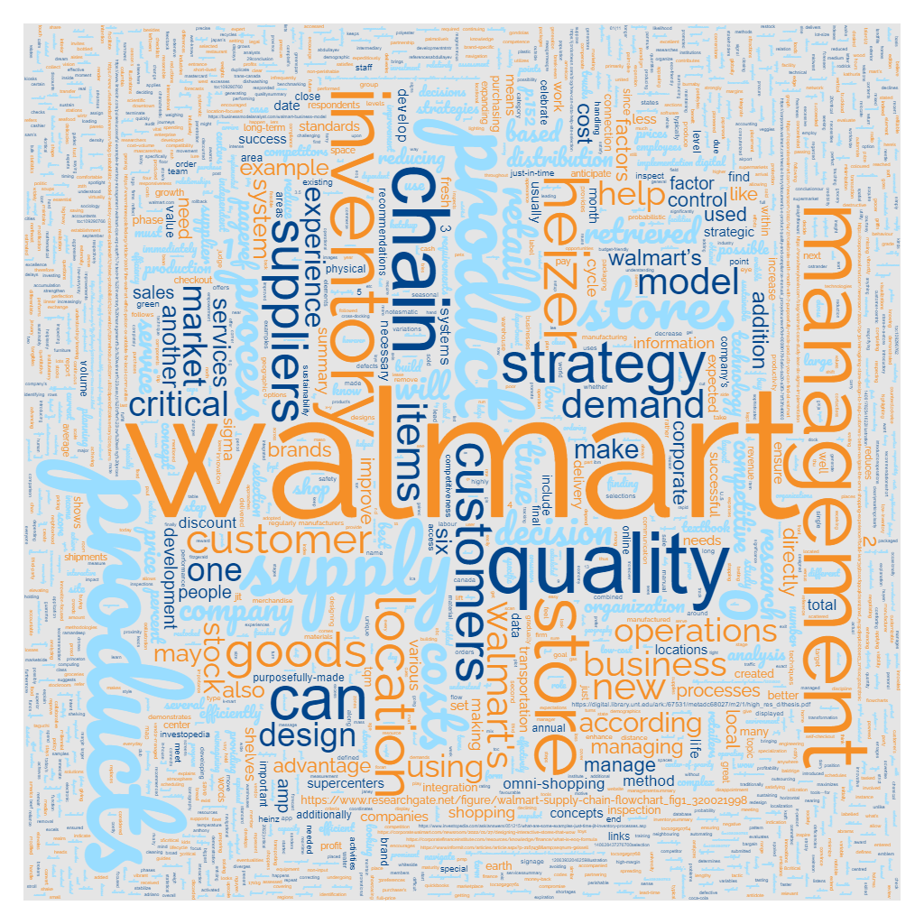
THANK YOU!
Ideas?
Thoughts?
Questions?
Remarks?

